Slide 1
Feature Testing
From Mirshekarian “Correlation of job-shop scheduling problem features with scheduling efficiency”

Slide 2
Testing Instance
Processing Times
Machine Id’s
1 | 2 | 3 | 4
1 | 2 | 3 | 4
1 | 2 | 3 | 4
1 | 2 | 3 | 4
1 | 2 | 3 | 4
1 | 2 | 3 | 4
J1
J1
J2
J2
J3
J3

Slide 3
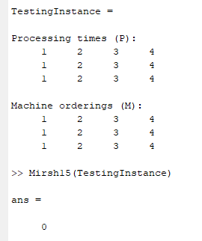
Mirsh 15
Standard Deviation of Job Processing Times divided by the mean of Job Processing Times
Feature Value of Raw Instance Data:
Job Processing Times = [10,10,10] (adding processing times of each jobs)
Standard Deviation of JPT = 0
Mean of JPT = 10
Mirsh15(TestingInstance) = (STD_JPT/mean_JPT) = 0/10 = 0

Slide 4
STEP with LPT
Processing Times
Machine Id’s
0 | 2 | 3 | 4
1 | 2 | 3 | 4
1 | 2 | 3 | 4
0 | 2 | 3 | 4
1 | 2 | 3 | 4
1 | 2 | 3 | 4
J1
J1
J2
J2
J3
J3

Slide 5
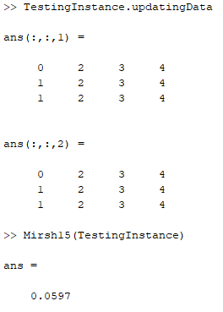
Mirsh 15
FEATURE VALUE
Job Processing Times = [9,10,10] (adding processing times of each jobs)
Standard Deviation of JPT = 0.5773
Mean of JPT = 9.6667
Mirsh15(TestingInstance) = (STD_JPT/mean_JPT) = 0.5773/9.6667 = 0.0597

Slide 6
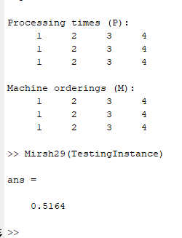
Mirsh 29
Standard Deviation of Machine Processing Times divided by mean of Machine Processing Times
Feature Value of Raw Instance Data:
Machine Processing Times= [3,6,9,12] (adding processing times of each machine)
Standard Deviation of MPT = 3.8729
Mean of MPT = 7.5
Mirsh29(TestingInstance) = (STD_MPT/mean_MPT) = 3.8729/7.5 = 0.5164

Slide 7
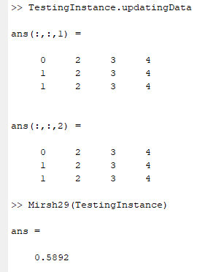
Mirsh29
Feature Value after step with LPT
Machine Processing Times= [2,6,9,12] (adding processing times of each machine)
Standard Deviation of MPT = 4.27
Mean of MPT = 7.25
Mirsh29(TestingInstance) = (STD_MPT/mean_MPT) = 3.8729/7.5 = 0.5892

Slide 8
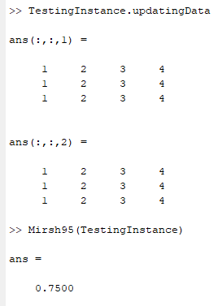
Mirsh 95
Mean of OSRMA divided by the number of machines
Feature Value of Raw Instance Data:
OSRMA values= [3,3,3,3] (machine repetitions on each operation slot amplified)
Mean of OSRMA = 3
Number of machines = 4
Mirsh95(TestingInstance) = (mean_OSRMA/nbMachines) = 3/4= 0.75

Slide 9

Mirsh 95
Feature value after step with LPT
OSRMA values= [1,3,3,3] (machine repetitions on each operation slot amplified)
Mean of OSRMA = 2.5
Number of machines = 4
Mirsh95(TestingInstance) = (mean_OSRMA/nbMachines) = 2.5/4= 0.625

Slide 10
Testing Instance
Processing Times
Machine Id’s
10 | 2 | 5 | 4
3 | 8 | 1 | 7
9 | 6 | 4 | 5
1 | 3 | 3 | 4
4 | 1 | 3 | 2
1 | 4 | 2 | 3
J1
J1
J2
J2
J3
J3

Slide 11
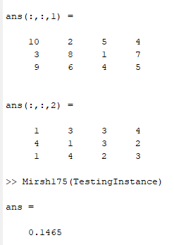
Mirsh 175
Mean of OSCOMBA divided by the product between the number of machines and the mean of Operation Processing Times
Feature Value of Raw Instance Data:
OSCOMBA values= [9.5,0,3,0] (machine repetitions on each operation slot amplified multiplied by the mean of their respective processing times)
Mean of OSCOMBA = 3.125
Mean of OPT = 5.333
Number of machines = 4
Mirsh175(TestingInstance) = (mean_OSCOMBA/(meanOPT*nbMachines)) = 3.125/(5.333*4)= 0.1465

Slide 12
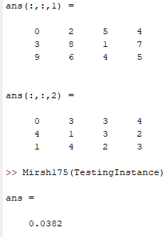
Mirsh 175
After step with LPT
OSCOMBA values= [0,0,3,0] (machine repetitions on each operation slot amplified multiplied by the mean of their respective processing times)
Mean of OSCOMBA = 0.75
Mean of OPT = 4.909
Number of machines = 4
Mirsh175(TestingInstance) = (mean_OSCOMBA/(meanOPT*nbMachines)) = 0.75/(4.409*4)= 0.03819
Notes:
Mean of OPT now is the sum of all PT / 11

Slide 13
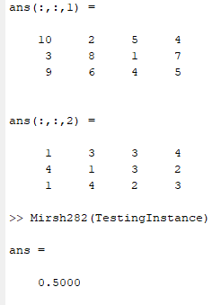
Mirsh 282
Mean of Machine Load Voids Amplified divided by the number of machines
Feature Value of Raw Instance Data:
Machine Load Voids Amplified= [3,3,1,1] (machine repetitions on each operation slot amplified)
Mean of MLDVA = 2
Number of machines = 4
Mirsh282(TestingInstance) = (mean_MLDVA/(nbMachines)) = 2/(4)= 0.5

Slide 14

Mirsh 282
Feature Value after step with SPT
Machine Load Voids Amplified= [3,3,1,3] (machine repetitions on each operation slot amplified)
Mean of MLDVA = 2.5
Number of machines = 4
Mirsh282(TestingInstance) = (mean_MLDVA/(nbMachines)) = 2.5/(4)= 0.625

